Slide 1


Self Service Delivery Order - Mauritius
User Guide
Notes:
“Every container has a destination or origin that is in need of some level of intermodal service. A Drayage/trucking move to/from a customer facility is always required + potentially a rail move to create cost effective solutions to/from inland locations. Today only 30% of NAMs volume had a rail or truck move attached making the opportunities numerous to grow our share of wallet for the intermodal product. ​We as Maersk can offer these services as an Integrated Product with our Ocean offering with a local dedicated Delivery Team to ensure a seamless execution. ​ The value for the customer is Ease of Business through the ability to focus on their own operation and now having multiple stakeholders (contracts, invoices etc) for the same shipment. ​
The customer has piece of mind leaving the SD delivery to Maersk as we will manage the risk of container delays in for instance the terminal unlike 3rd party trucking companies who charges waiting times and congestion fees as incremental charges.​ Further the Maersk Store Door offering offers potential cost savings that we as Maersk can deliver through economies of scale across multiple customers.”

Slide 2

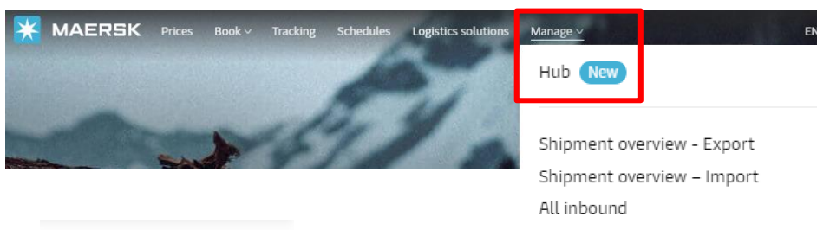

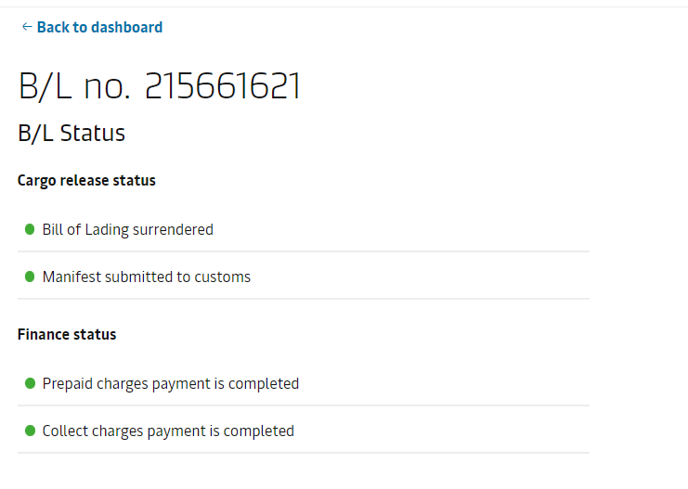
Step 1
Are you a cash customer?
Send the Proof of payment to: safhtfrc@maersk.com
Login to www.maersk.com
Click → Manage → HUB → Delivery Order
Check your release status with the help of our ‘traffic lights’
If all green – move to step 2

Slide 3
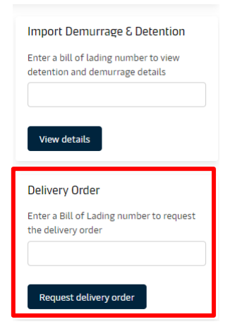
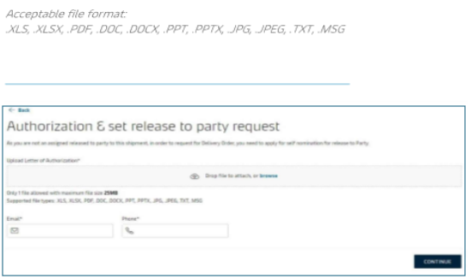
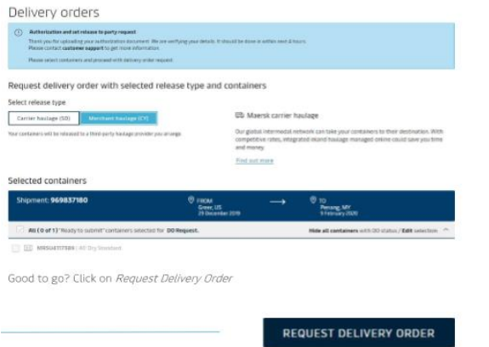

Step 2
In the Delivery order widget,
input shipment number & click on Request Delivery Order
Scenario A
Are you the consignee?
If Yes, request for your Instant DO
Click on” Request Delivery Order”
Scenario B
Are you the appointed broker/forwarder?
Upload the consignee’s LOA (Letter of Authorisation) & click “continue”

Slide 4
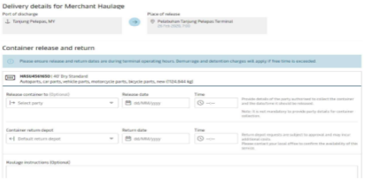
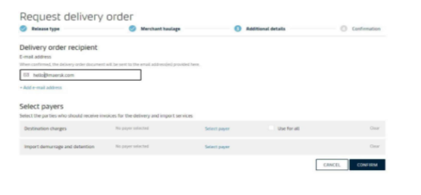
Final –Step 3!
In the ' Release container to' field:
Update party (broker's name to be inserted under Trading name)
Search & confirm
Your email address will be displayed by default
Add any other email address if desired & confirm

